Slide 1
Statistics for CSAI II
13 – Wrapping up, Q&A
Travis J. Wiltshire & Sasha Kenjeeva

Slide 2
Please evaluate the course!

Slide 3
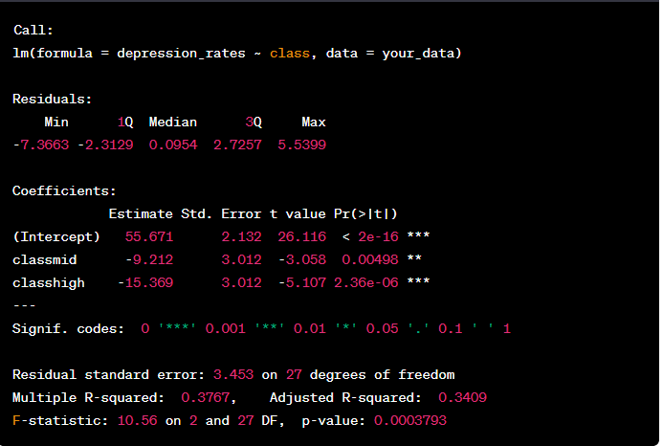
Notes:
- what does the output represent (formula)?
- how many levels of the categorical variable are there?
- what does the intercept represent?
- is being middle class conductive to depression?

Slide 4
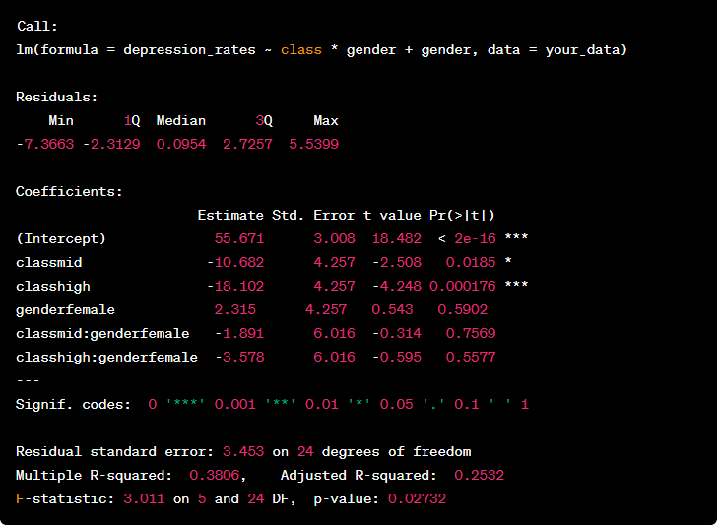
Notes:
- Does adding gender make sense? Why? Why not?

Slide 5
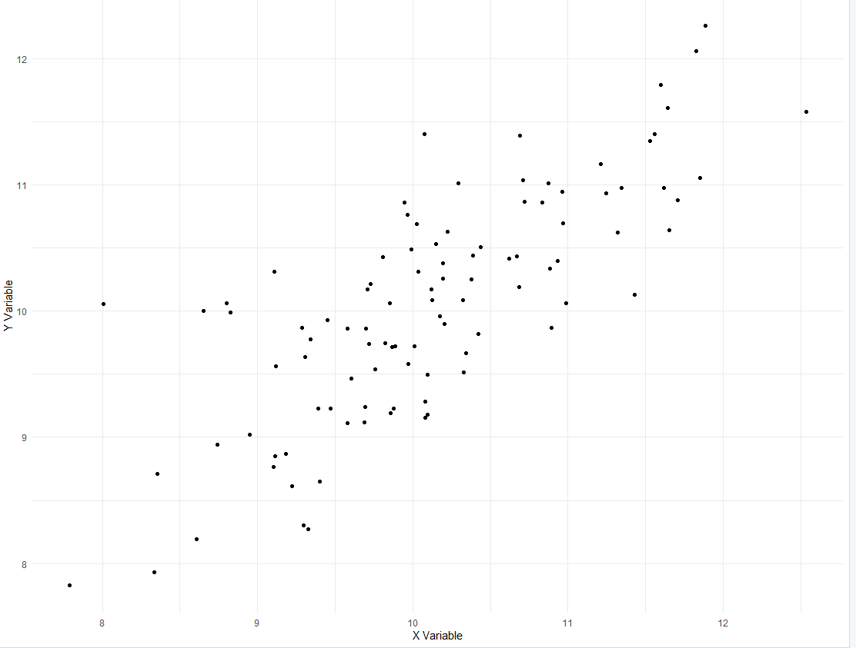
Notes:
- what’s the correlation?

Slide 6
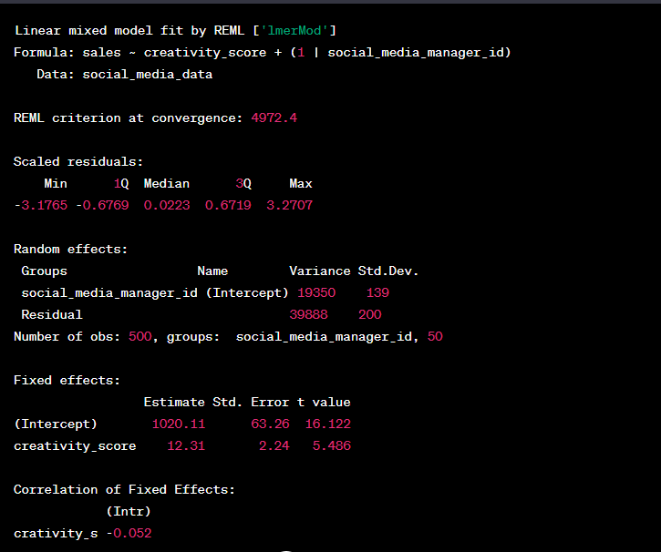
Notes:
- what are we testing?
- what kind of model is this?
- what does the intercept mean?

Slide 7
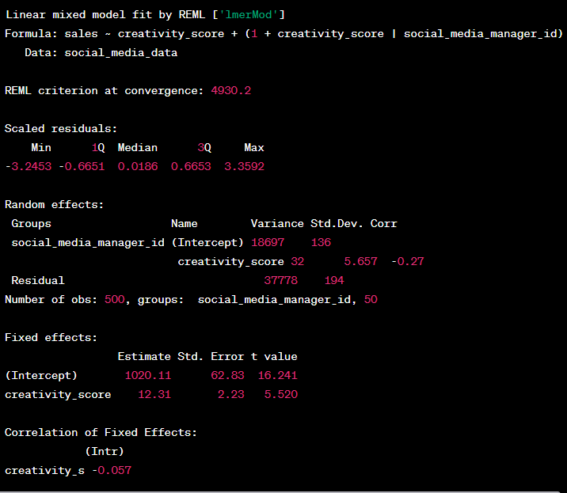
Notes:
- how can you explain the random effects section?

Slide 8
Exam Q & A

Slide 9
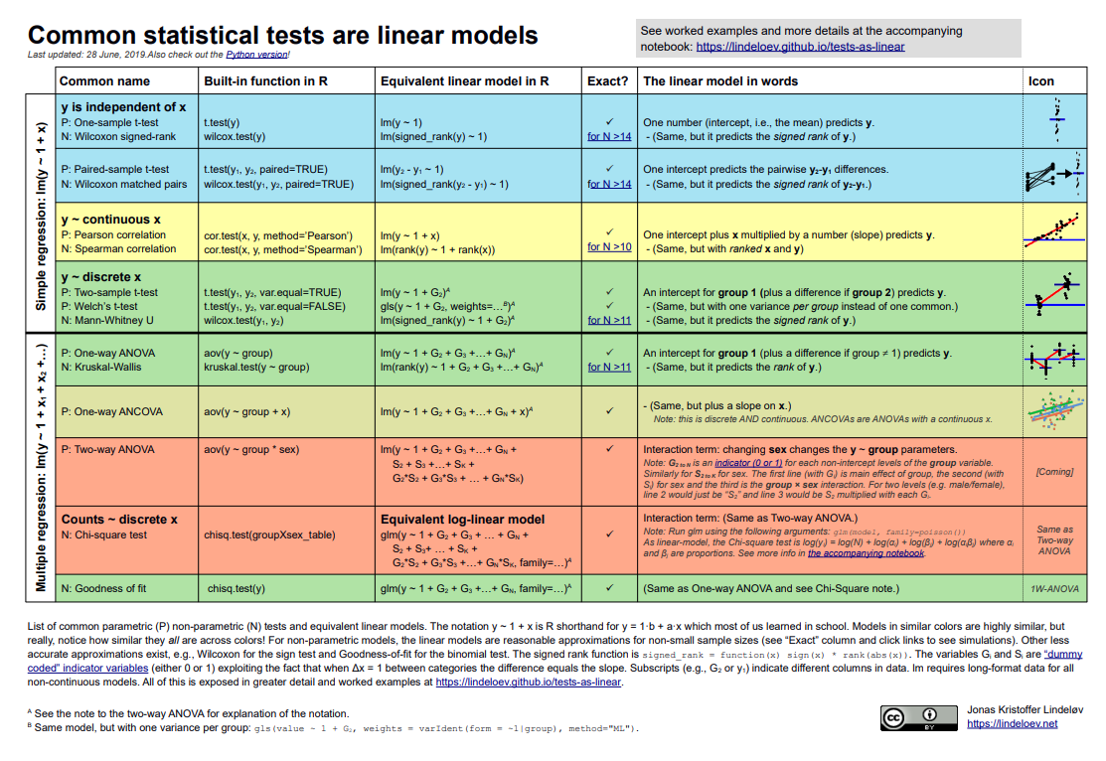
Statistics Wrap Up
Statistical decision making isn’t easy
Model based approaches can be better than mean comparisons
Beware of misusing p-values or following the null ritual
Your best guide is to be driven by theory and prior empirical work for developing your research questions/experiments, and then you choose the best statistical tool to answer that (avoid using a tool to guide your RQs).

Slide 10
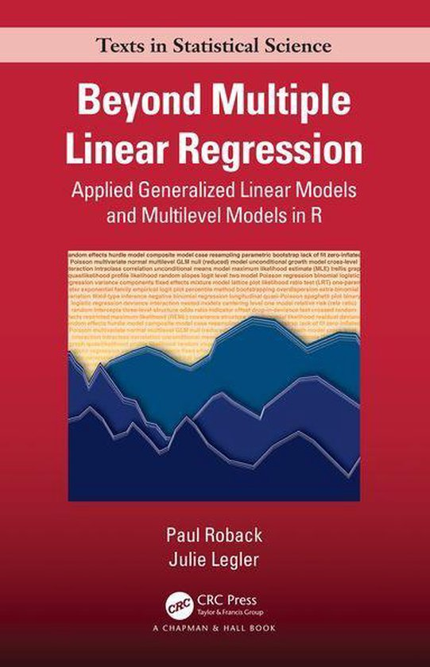
Want to build on your statistics knowledge?
Roback, P., & Legler, J. (2021). Beyond multiple linear regression: applied generalized linear models and multilevel models in R. Chapman and Hall/CRC.
https://bookdown.org/roback/bookdown-BeyondMLR/

